Slide 1

Multilevel Groundwater Monitoring of Hydraulic Head and Temperature in the Eastern Snake River Plain Aquifer, 2007 to 2008
Jason C. Fisher and Brian V. Twining
U.S. Department of the Interior
U.S. Geological Survey
Notes:
Today I’ll be discussing multilevel groundwater monitoring of hydraulic head and temperature in the eastern Snake River Plain aquifer. Data will be presented for the 2007 and 2008 calendar years. My co-author on this project was Brian Twining, also with the INL project office. This research was conducted by the U.S. Geological Survey in cooperation with the Department of Energy.

Slide 2
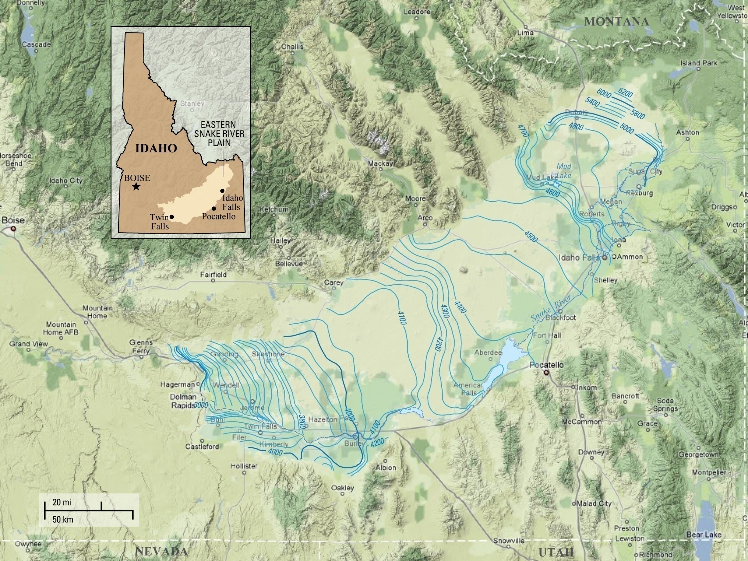
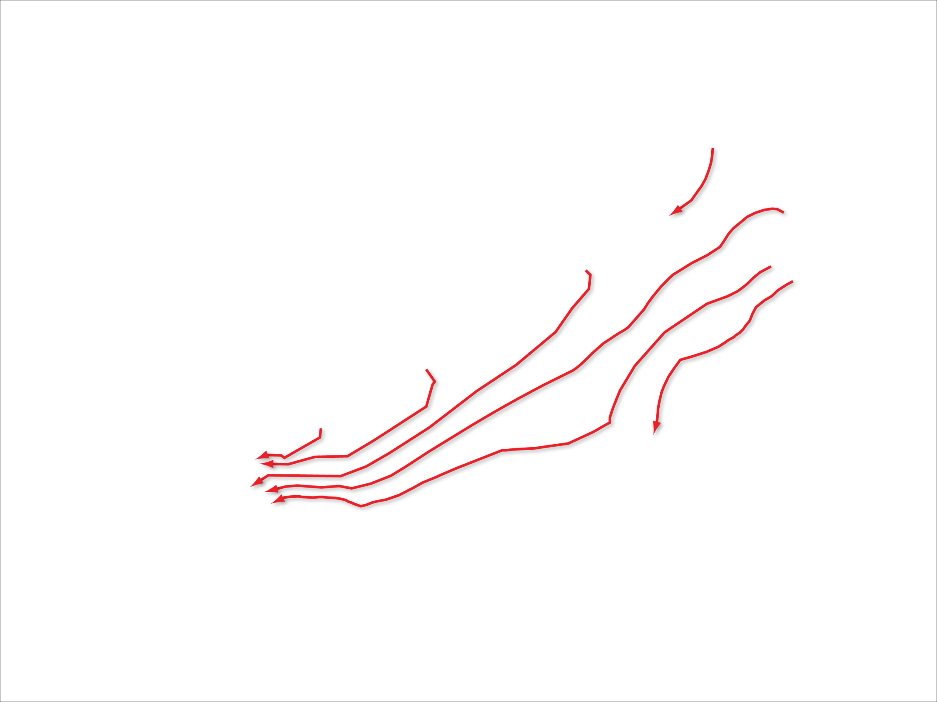
Notes:
The area of interest is within Idaho’s eastern Snake River Plain aquifer, a relatively flat topographic depression, about 200-miles long and 50- to 70-miles wide. The aquifer is surrounded by mountains on three sides and rimmed by the Snake River near the edges of its eastern and southern boundaries and by canyons along its southwestern boundary. The aquifer is primarily composed of fractured basalts, interflow zones, and interbedded sediments.
The 1980 water-table, shown here as line contours of equal hydraulic head, shows a southwest regional flow direction with groundwater moving from the Yellowstone Plateau in the northeast to the Thousand Springs area in the southwest with a total water-level drop of approximately 3200 ft.

Slide 3
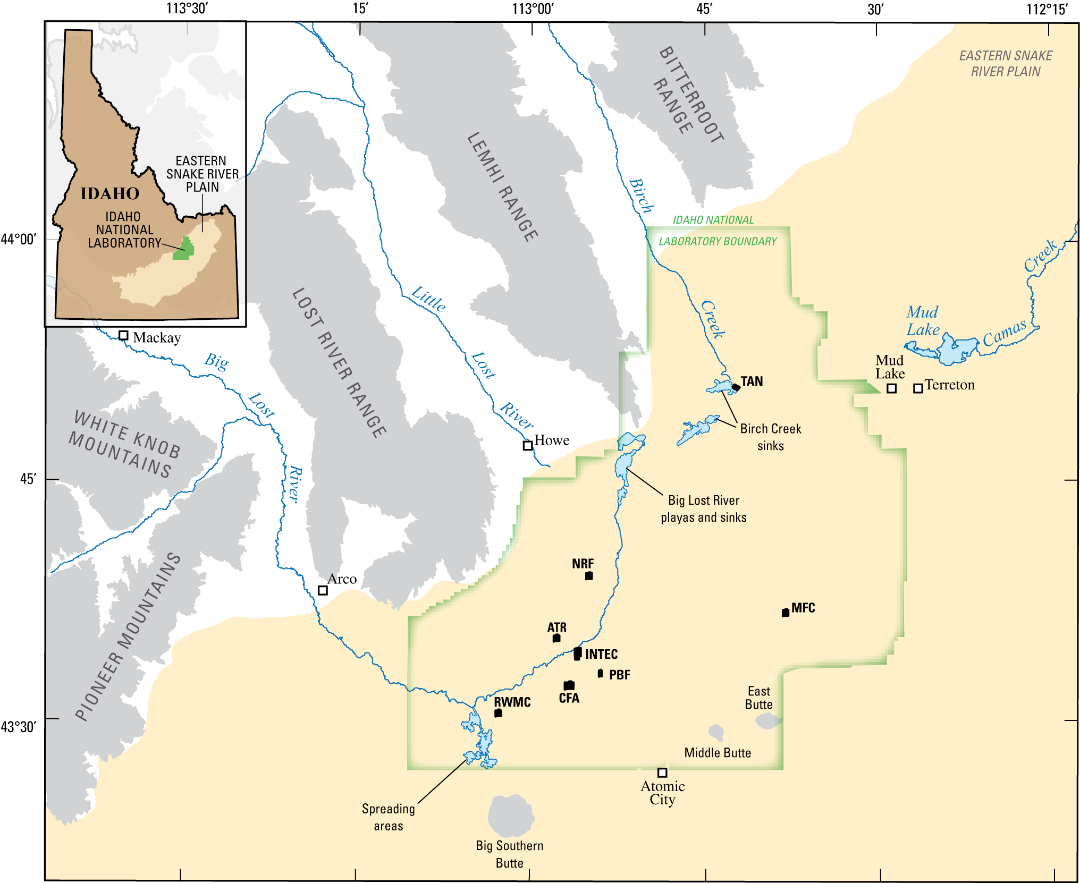
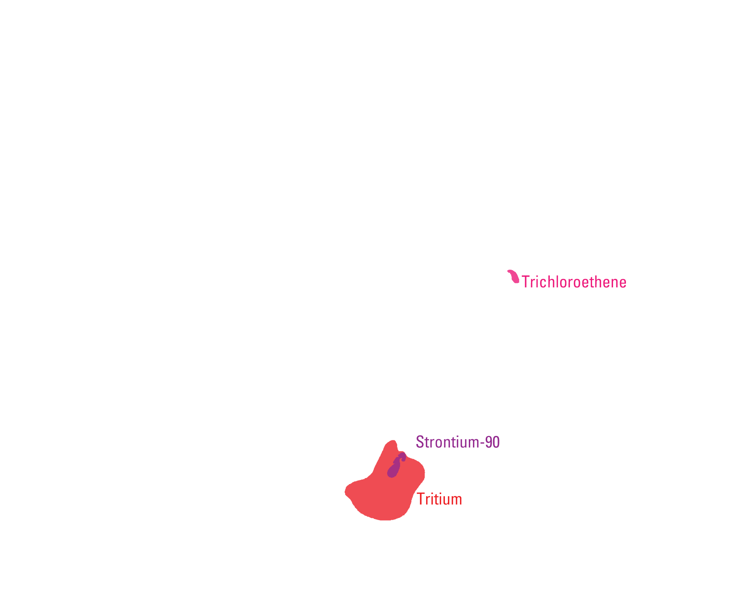
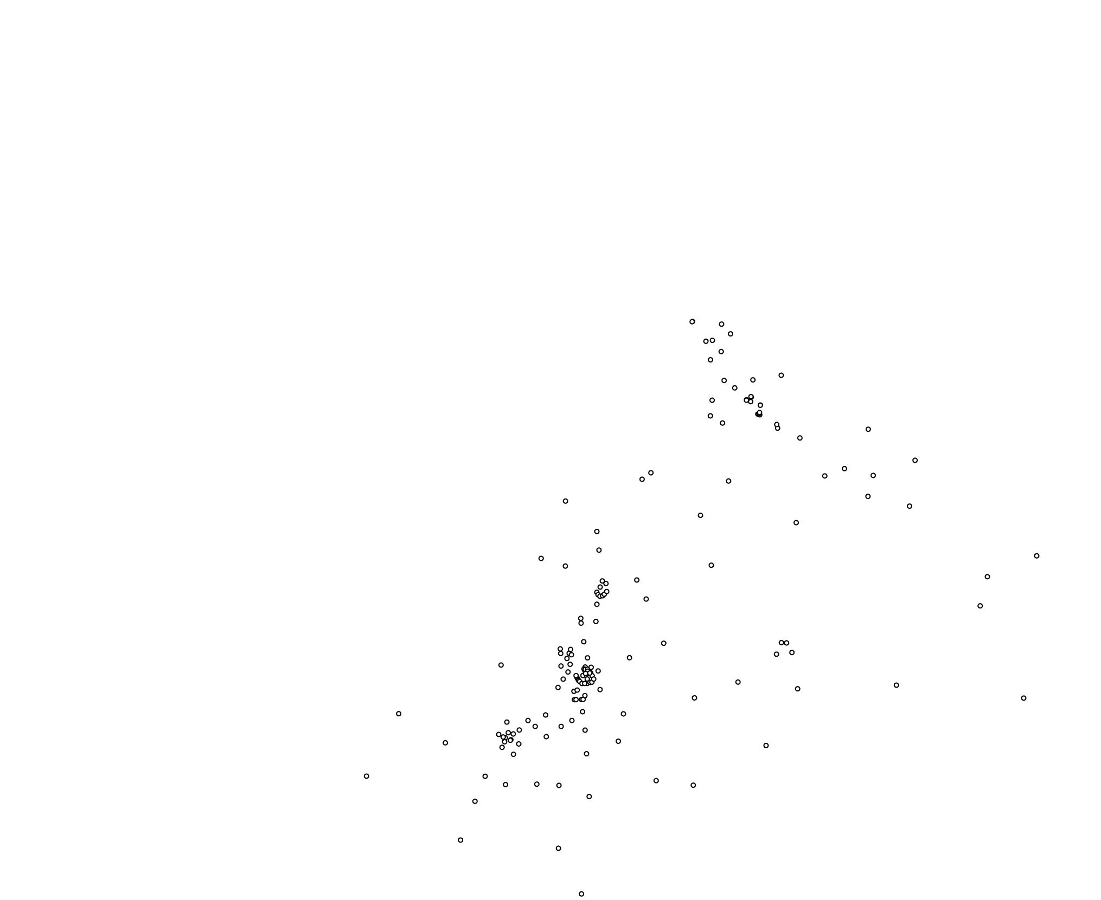

Notes:
The study site is located in the west-central part of the plain and within the boundaries of the Idaho National Laboratory (INL). The INL was established in 1949 to build, operate, and test nuclear reactors. A 50-plus year history of waste disposal at the INL has resulted in measurable concentrations of contaminants in the aquifer beneath the INL. The principal sources of contaminants are wastewater-disposal sites at Test Area North (TAN), the Naval Reactors Facility (NRF), the Advanced Test Reactor complex (ATR), and the Idaho Nuclear Technology and Engineering Center (INTEC).
Contaminants include trichloroethene, stronntium-90, and tritium; as well as, chlorine-36 and iodine-129 which have been detected in monitoring wells downgradient of ATR and INTEC. Note that little data is available to characterize the true areal extent and shape of these plumes. Also, it’s difficult to determine the long-term risks associated with contaminants that are present in the aquifer today or might be present in the future because of slow releases of residual contamination present in the unsaturated zone.
For more than fifty years a network of monitoring wells has recorded water-level and water-quality observations in over 200 boreholes with variable lengths of record. Most boreholes penetrate only the upper portion of the aquifer and are completed as open holes; therefore, little data is available to describe the vertical distribution of contaminants within the aquifer.
Starting in 2005, multilevel monitoring systems were installed in six boreholes within the INL to provide the necessary means to better characterize the vertical movement of water and contaminants in the aquifer. These boreholes include USGS 103, 132, 133, 134, MIDDLE 2050A, and 2051.

Slide 4
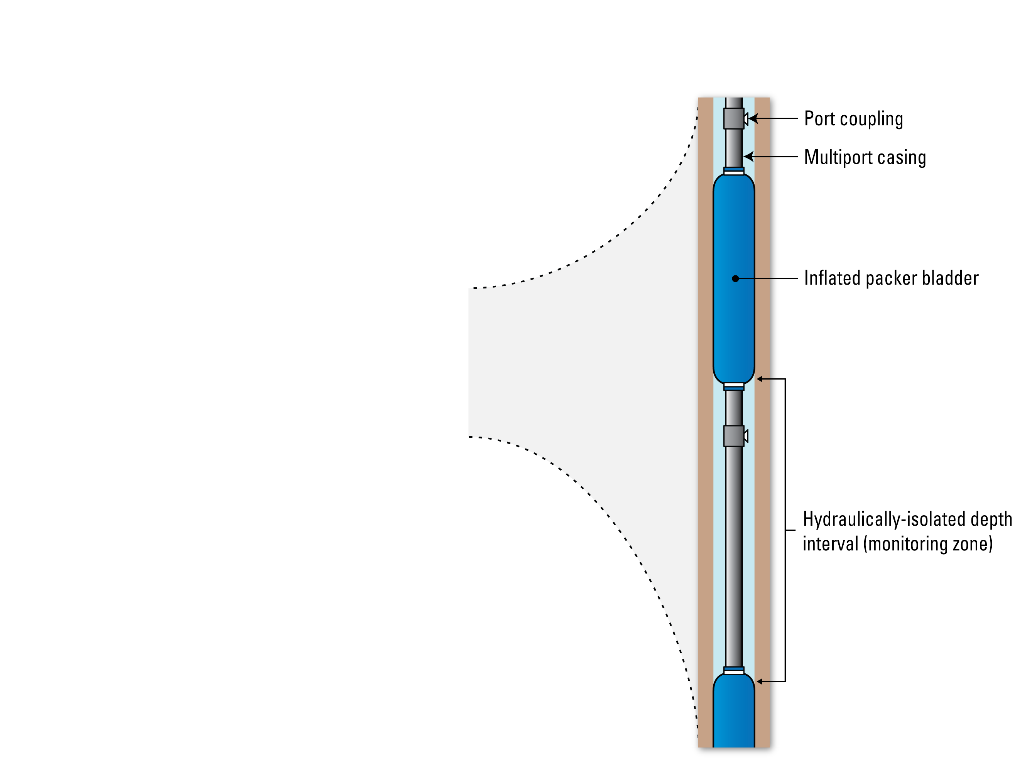
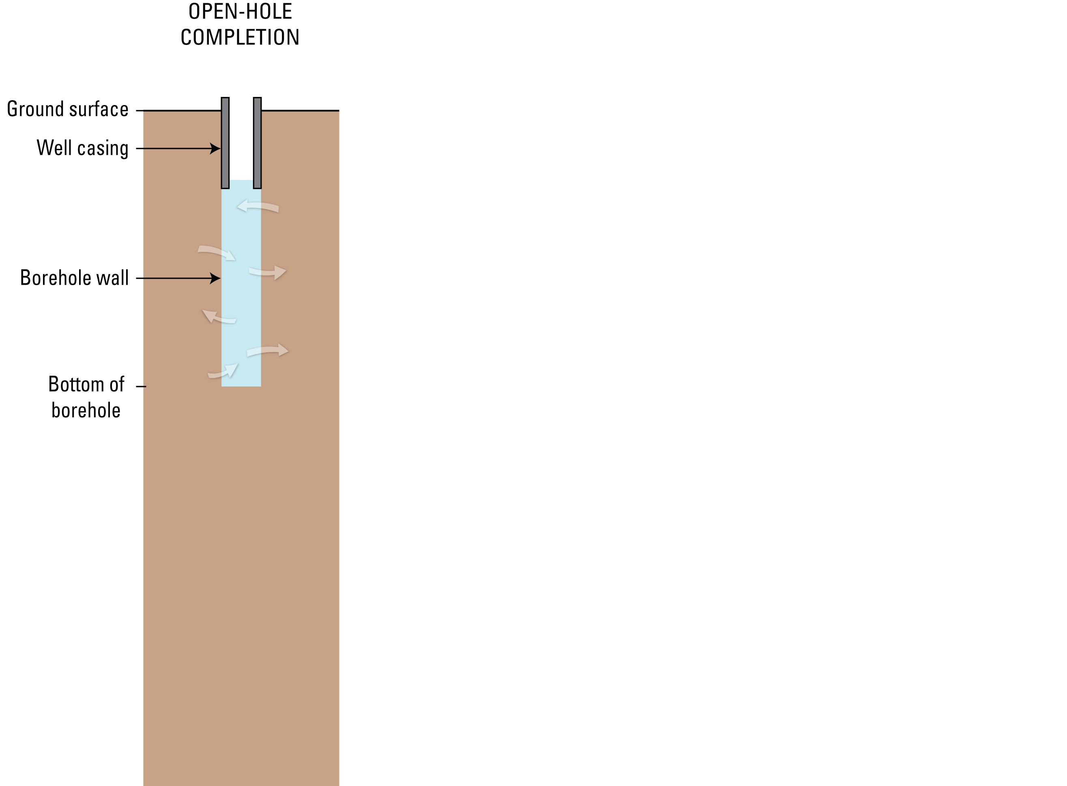
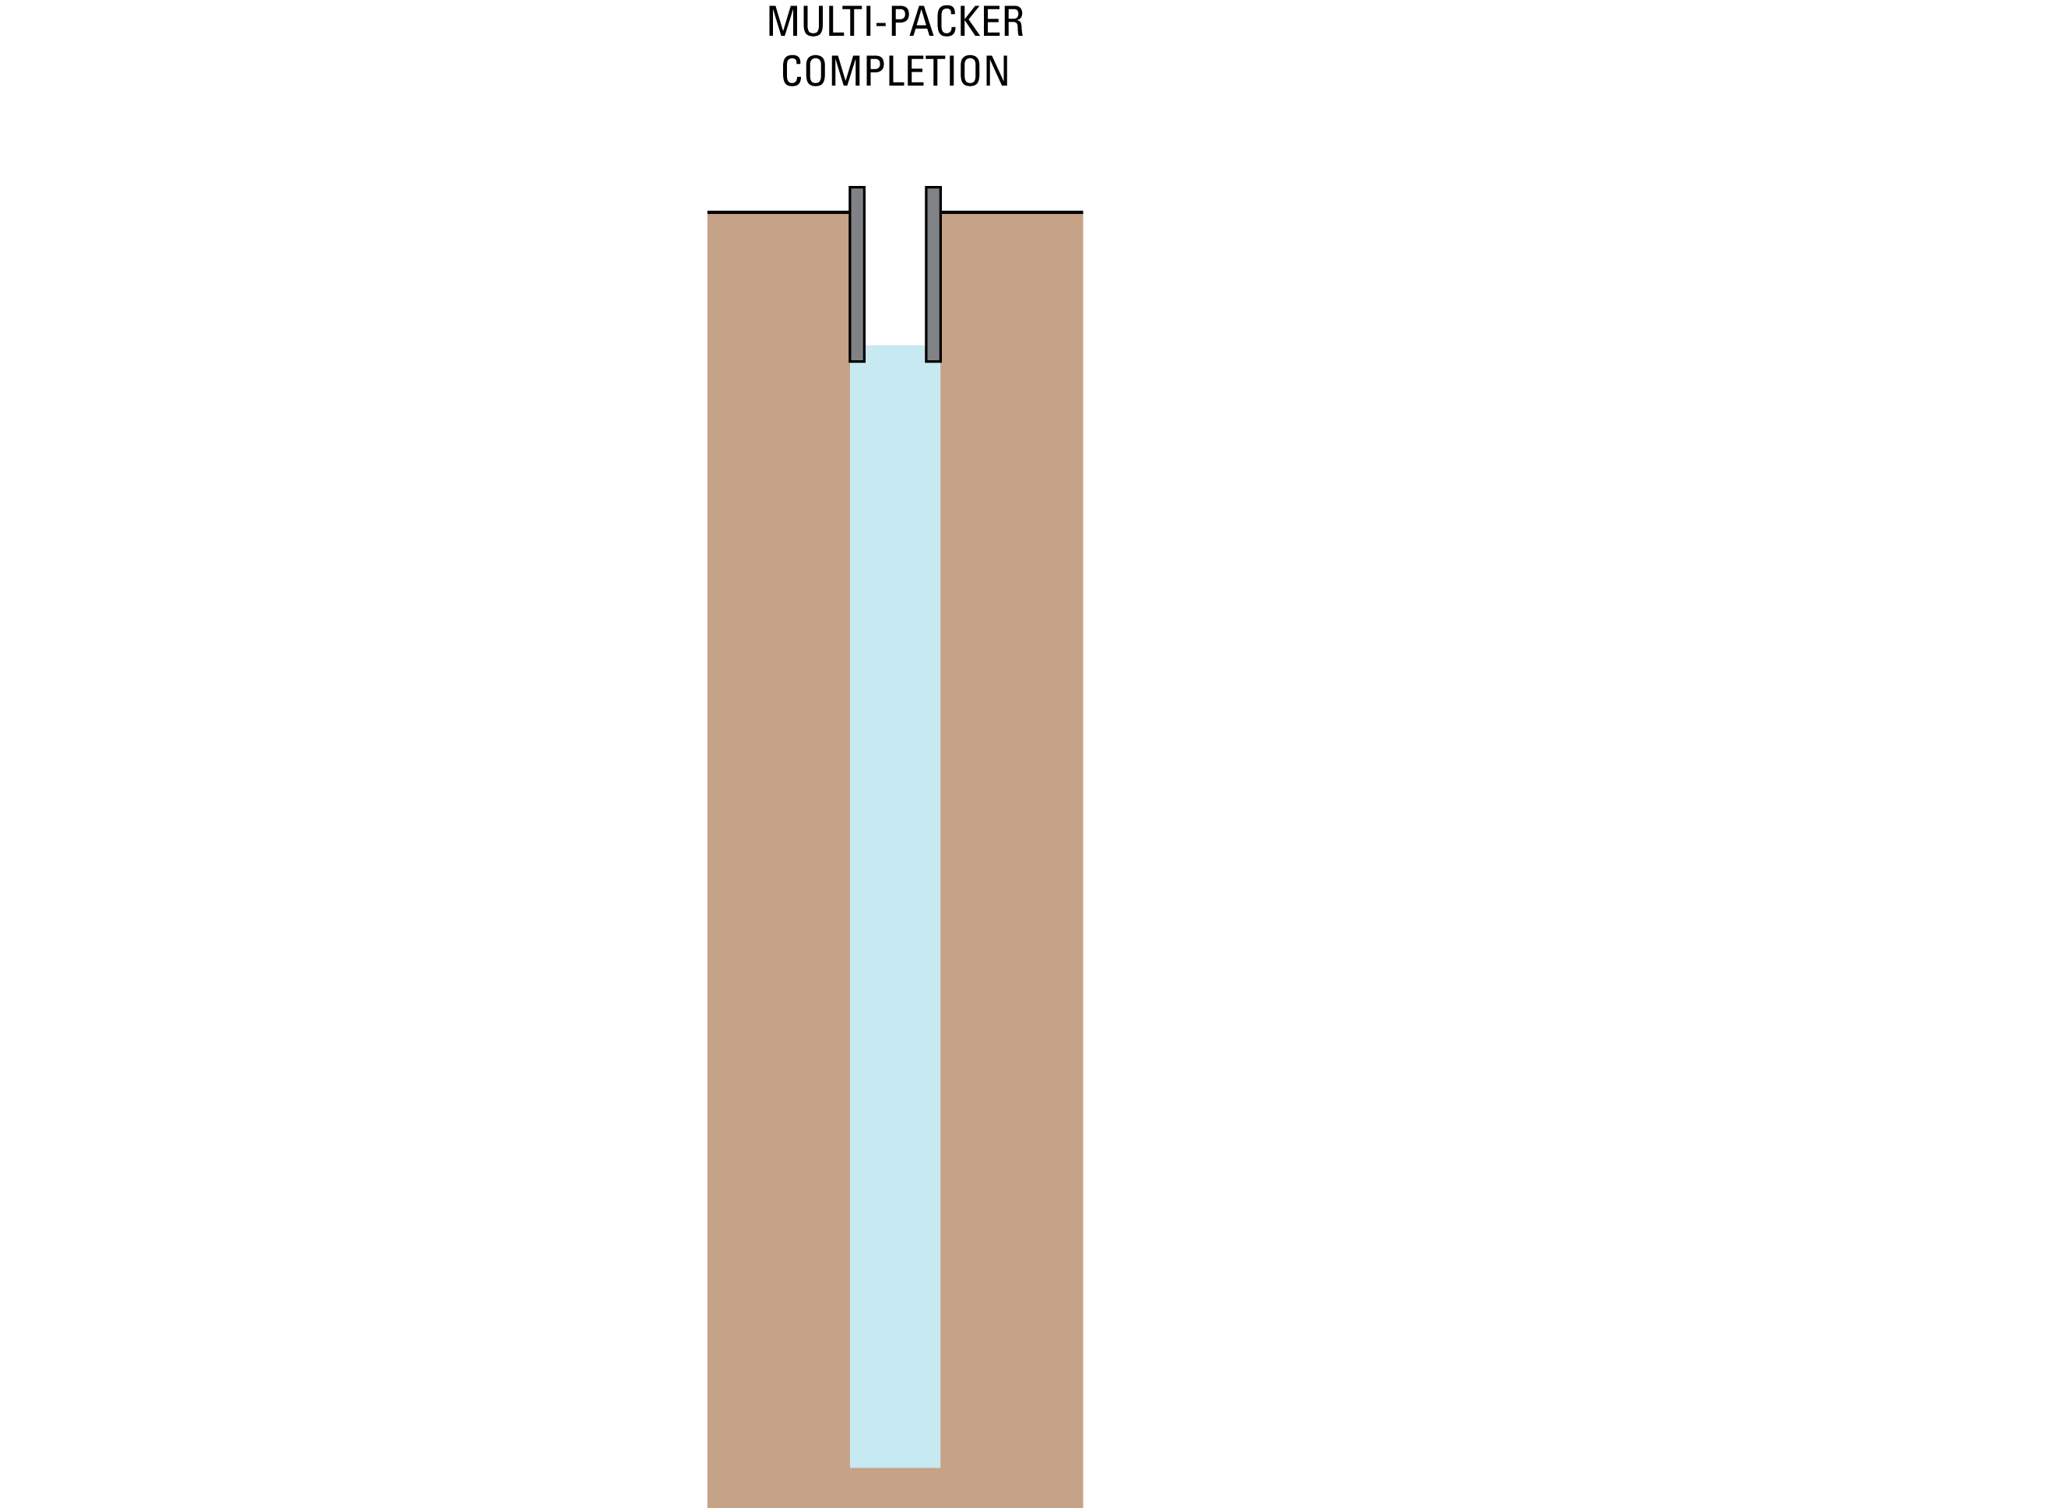
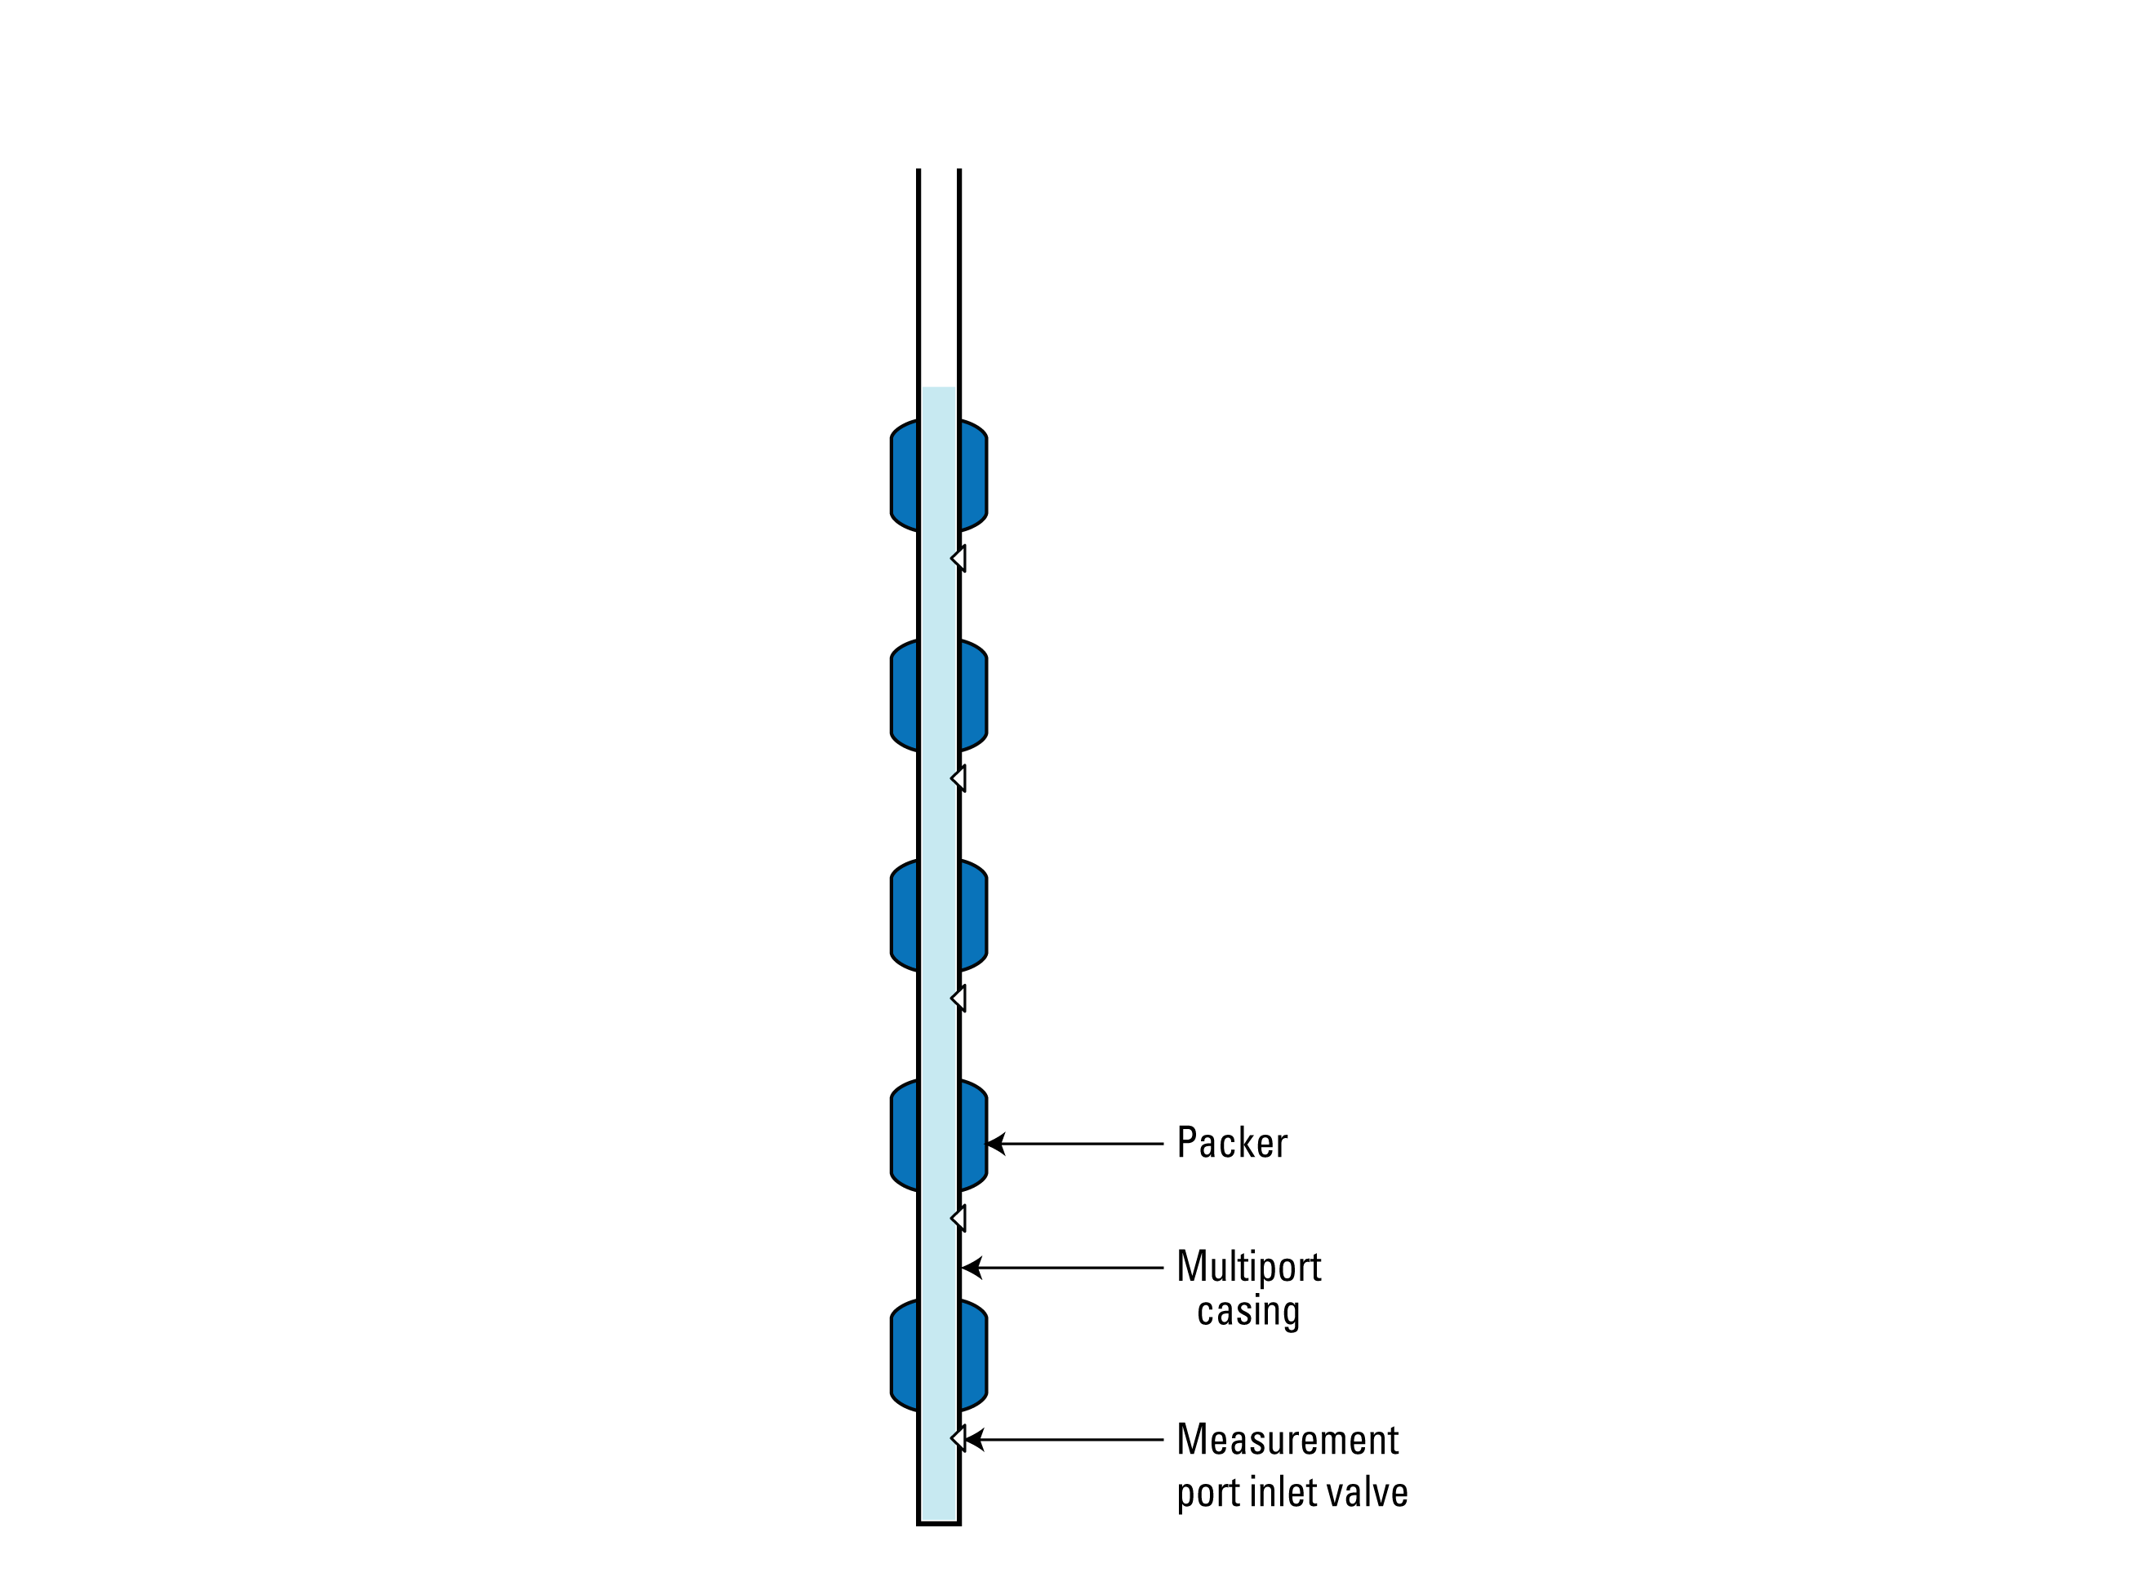
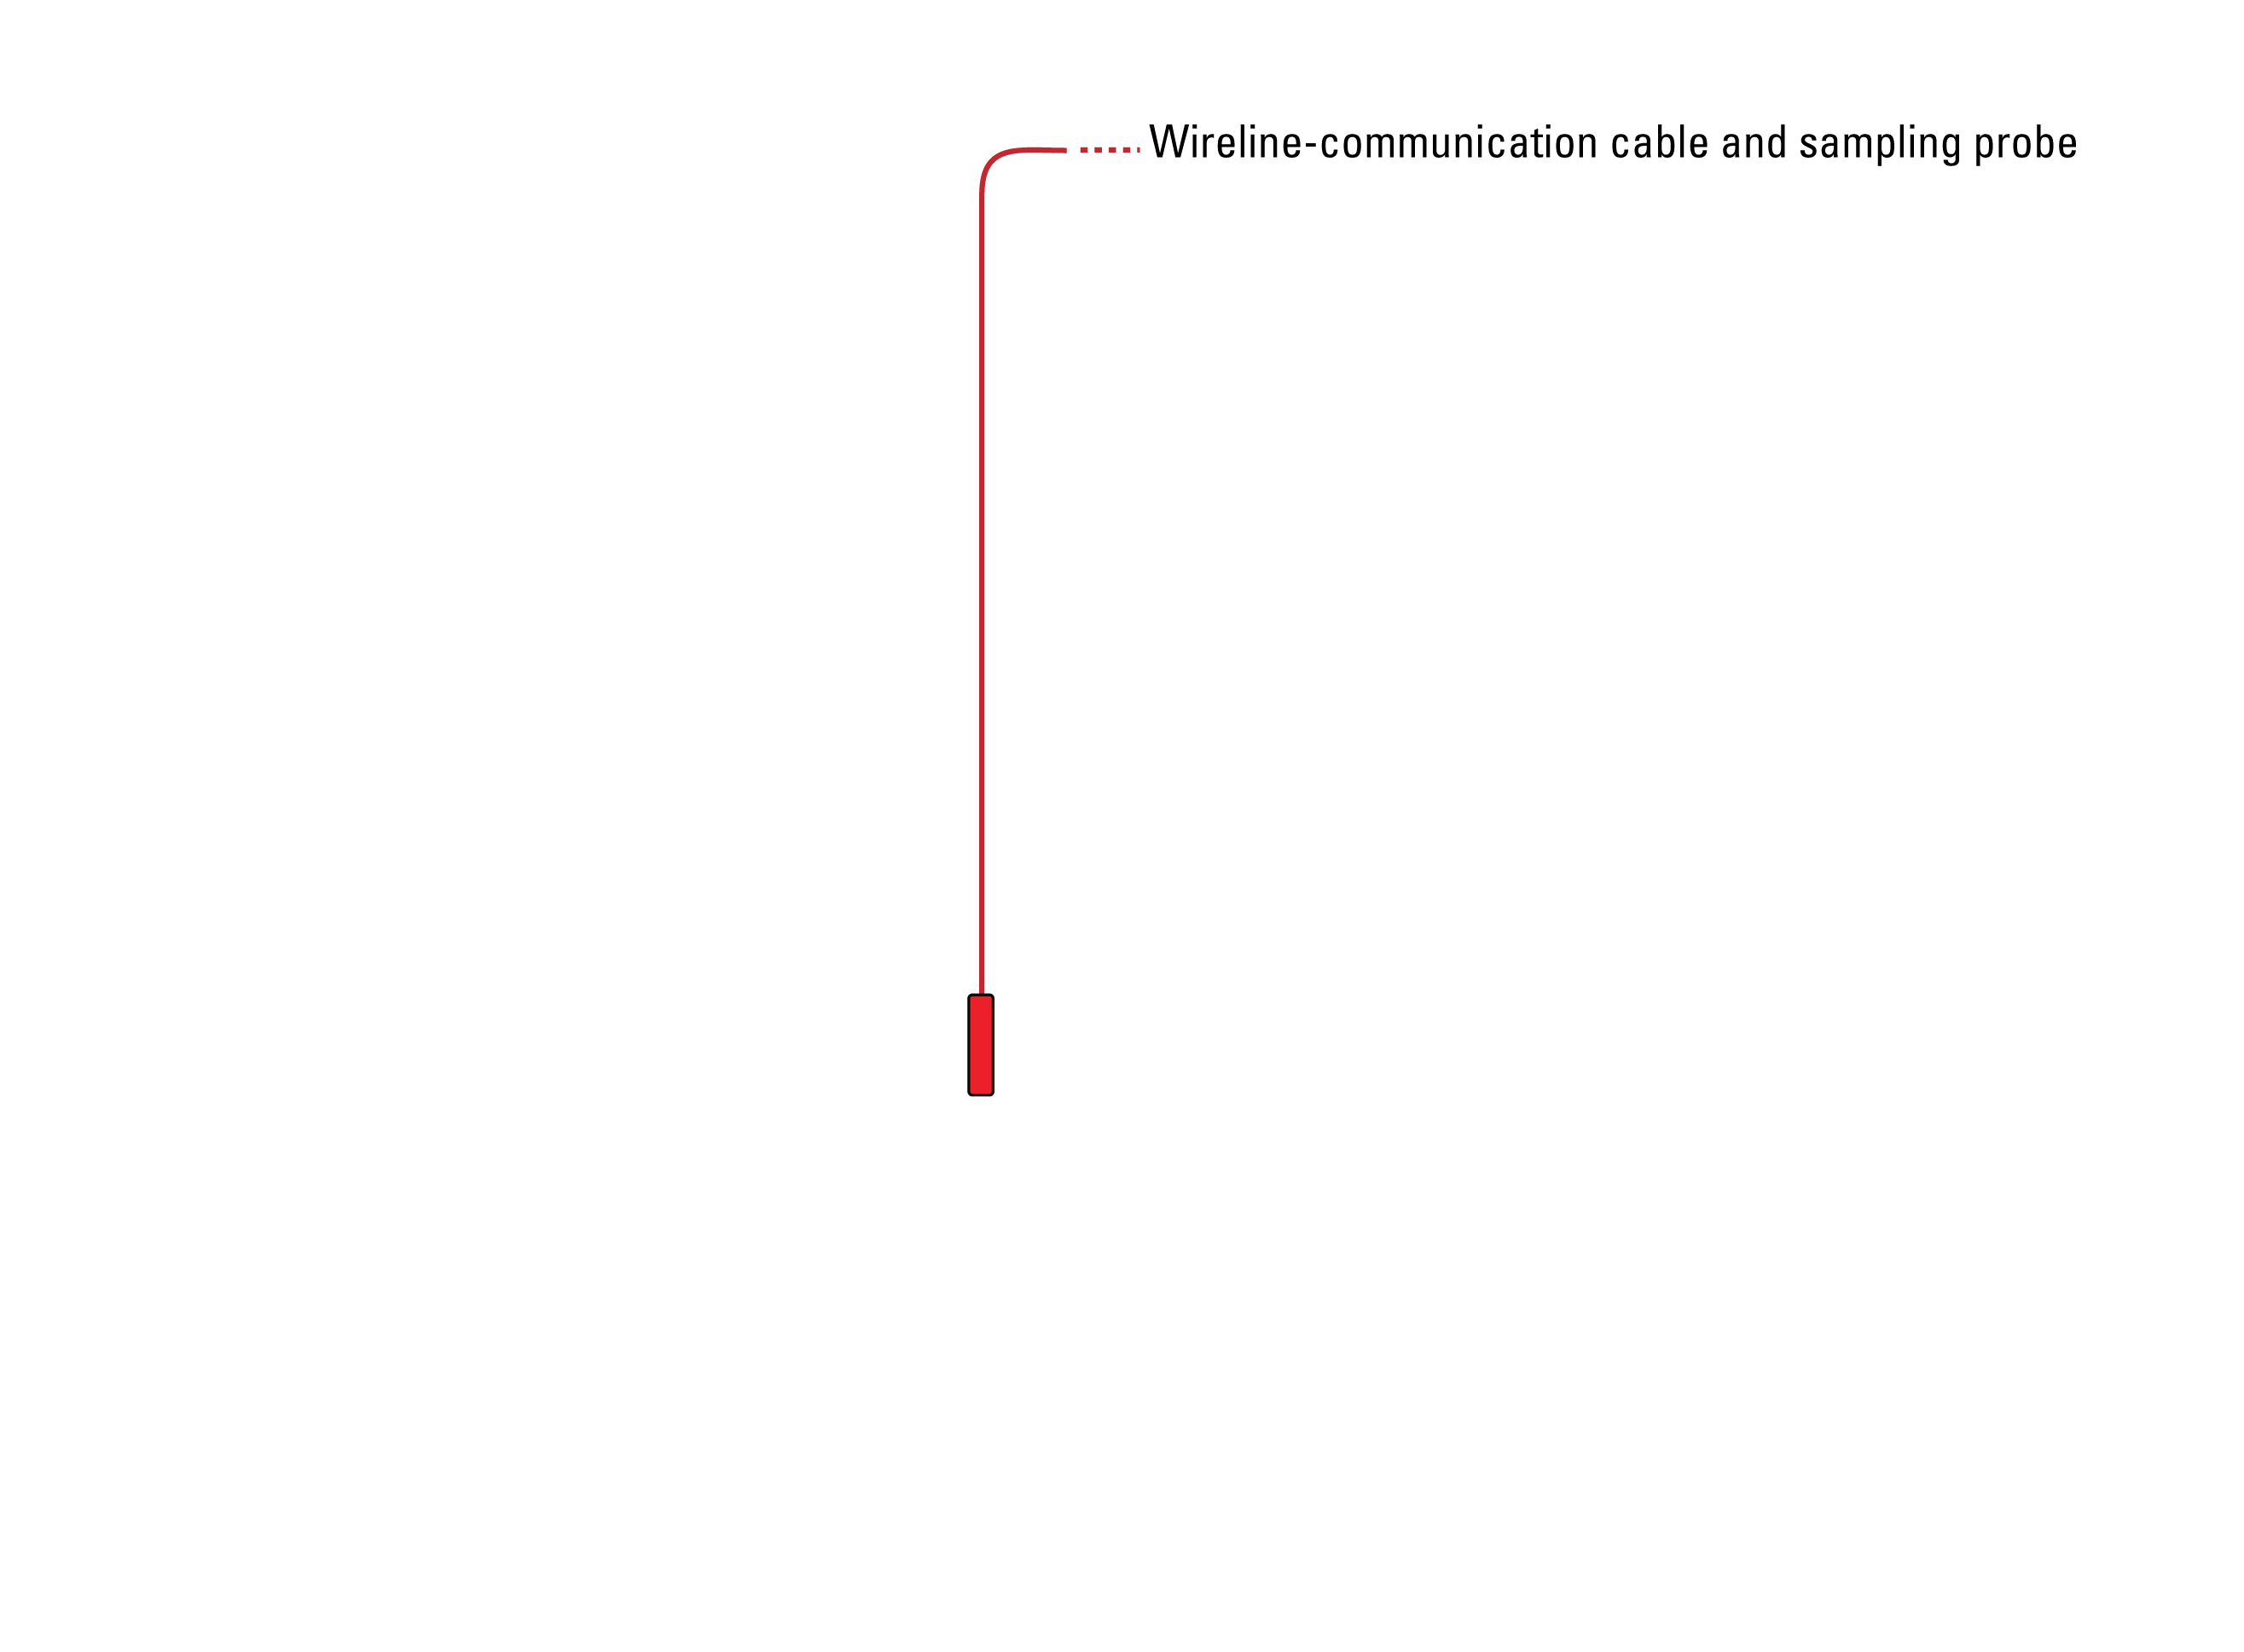
Notes:
Typical monitoring wells at the site are completed as open boreholes, penetrate the upper 50- to 150-ft of the aquifer, and allow unrestricted groundwater flow into (or out of) the open borehole. Measurements collected from these open-hole wells are independent of depth and represent, at best, a vertically-averaged composite value for the borehole that is heavily weighted by the highest hydraulic conductivity feature penetrated by the borehole.
In comparison, the multilevel monitoring systems were installed in boreholes that penetrate the upper 400- to 950-ft of the aquifer.
The design allows for depth-discrete monitoring of hydraulic head and temperature, and the collection of depth-discrete samples for water-quality analysis. The system uses a continuous string of water-tight casing (PVC) that runs the entire length of the borehole.
Inflated packer bladders are used to maintain hydraulic isolation between monitoring zones.
Fluid pressure and temperature measurements are made using a wireline-operated sampling probe that is lowered into the multiport casing from the land surface and positioned at a selected measurement port coupling. The positioned probe is then coupled with the inlet valve to allow monitoring of groundwater outside the multiport casing and within the monitoring zone.

Slide 5
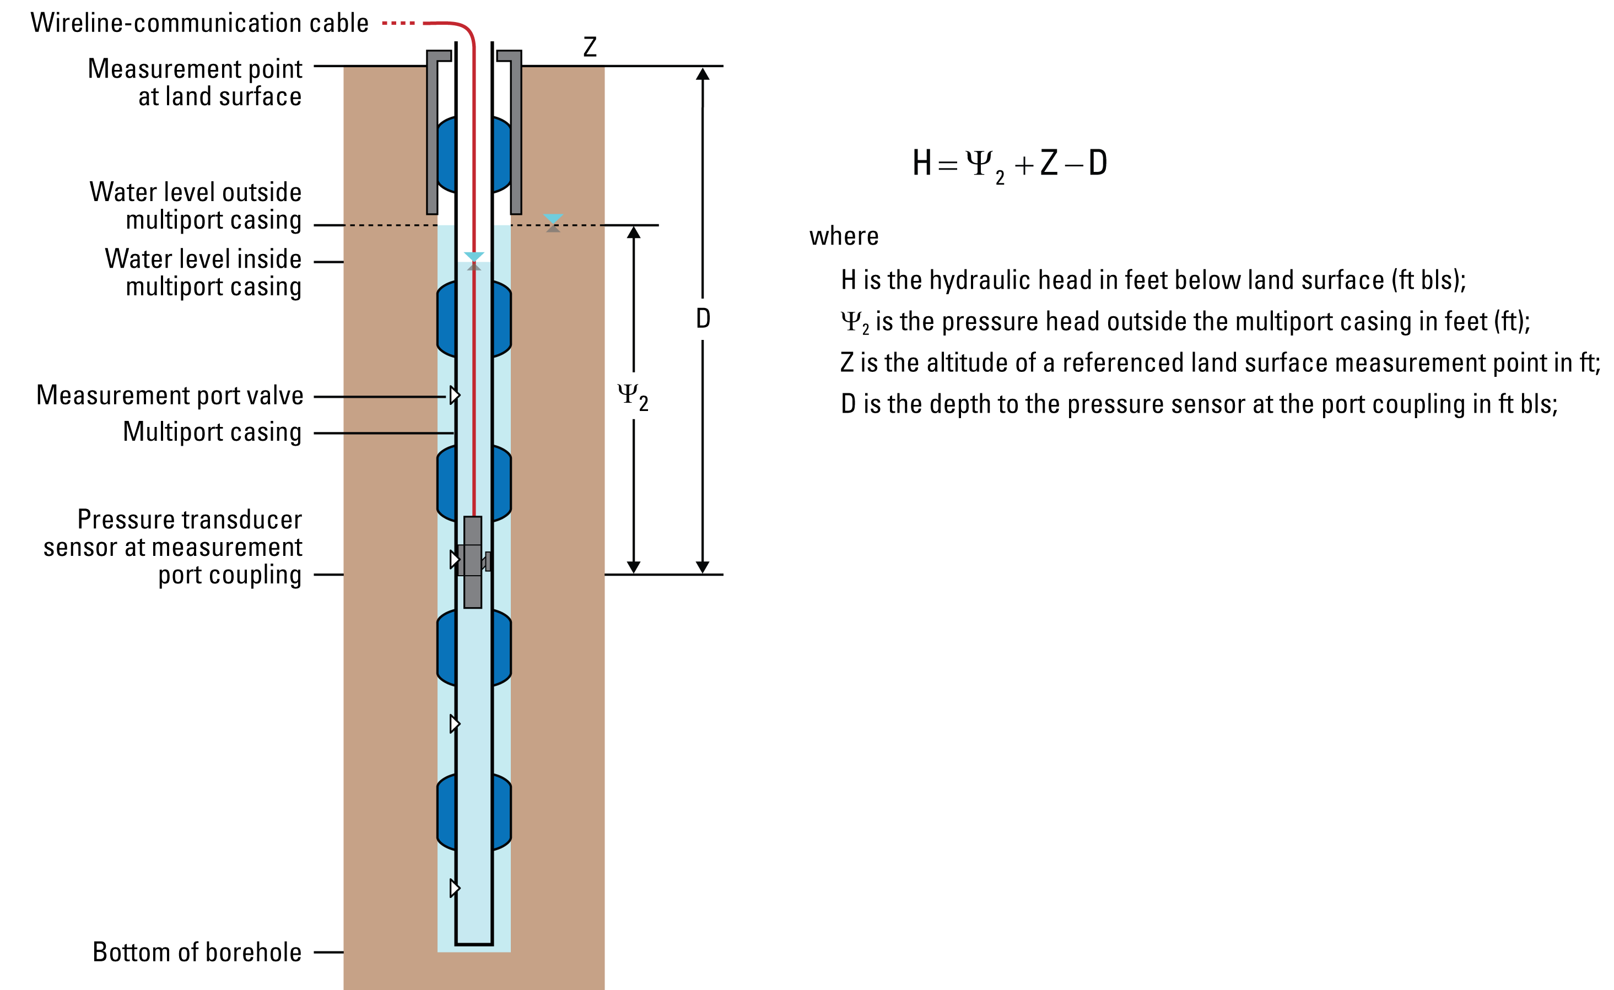
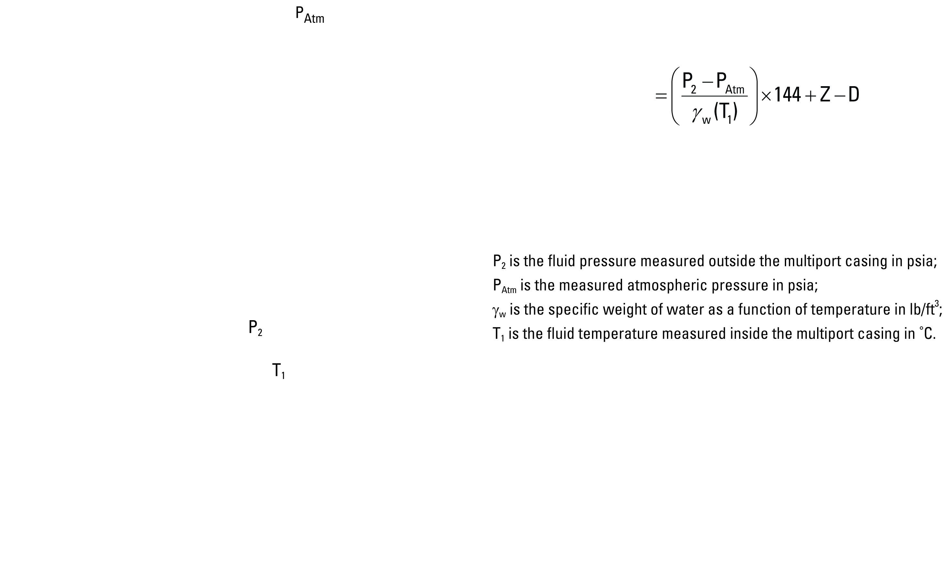
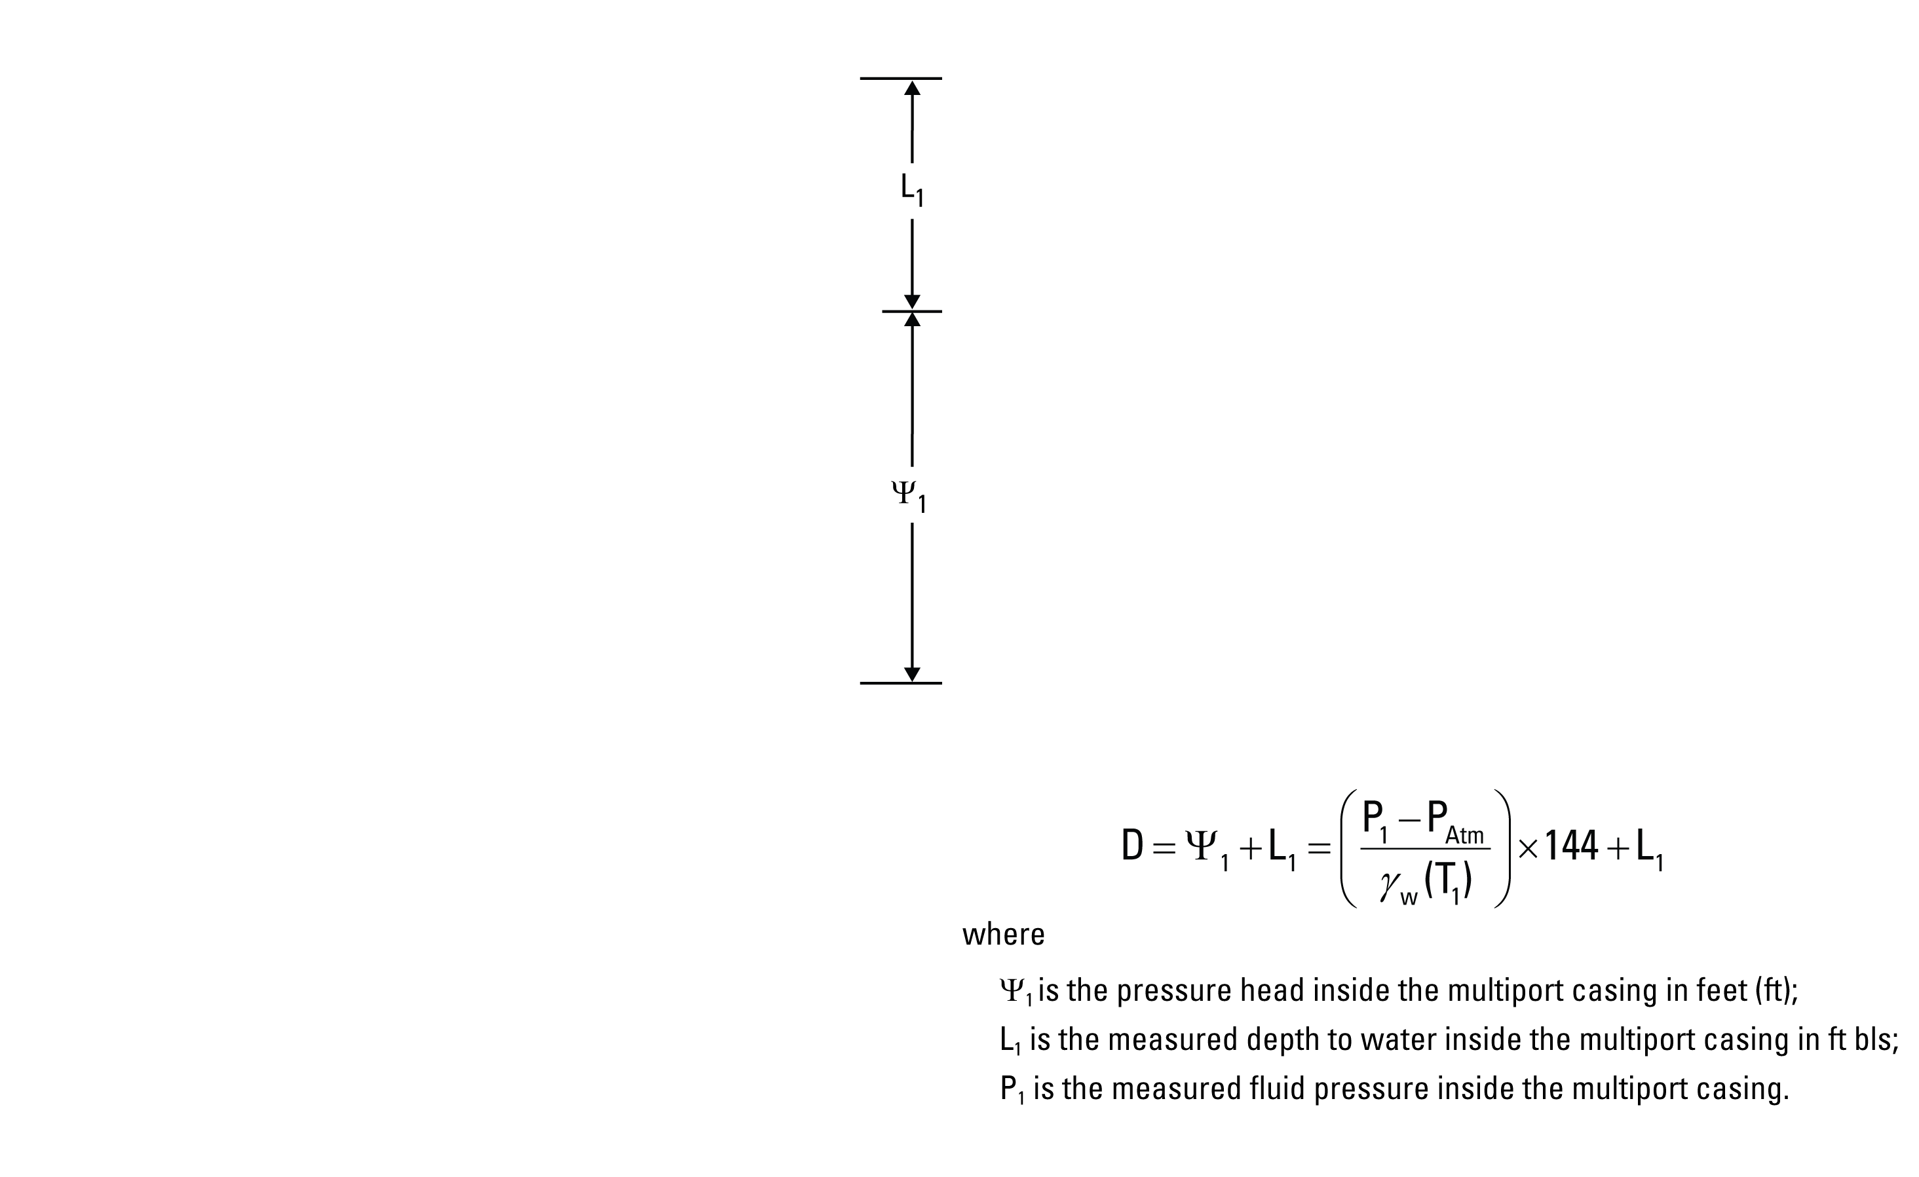
Notes:
The hydraulic head at a port coupling is equal to fluid pressure measured by the sampling probe outside the multiport casing minus the atmospheric pressure measured at the land surface, all of this is then divided by the specific weight of water as a function of temperature only and all added to the elevation head. Assumption include: 100% barometric efficiency for atmospheric pressure, and a gravitational acceleration and salinity that do not change with depth.
The depth to the pressure transducer (D) was measured once using the pressure head inside the multiport casing plus the measured depth to the air water interface within the borehole.

Slide 6
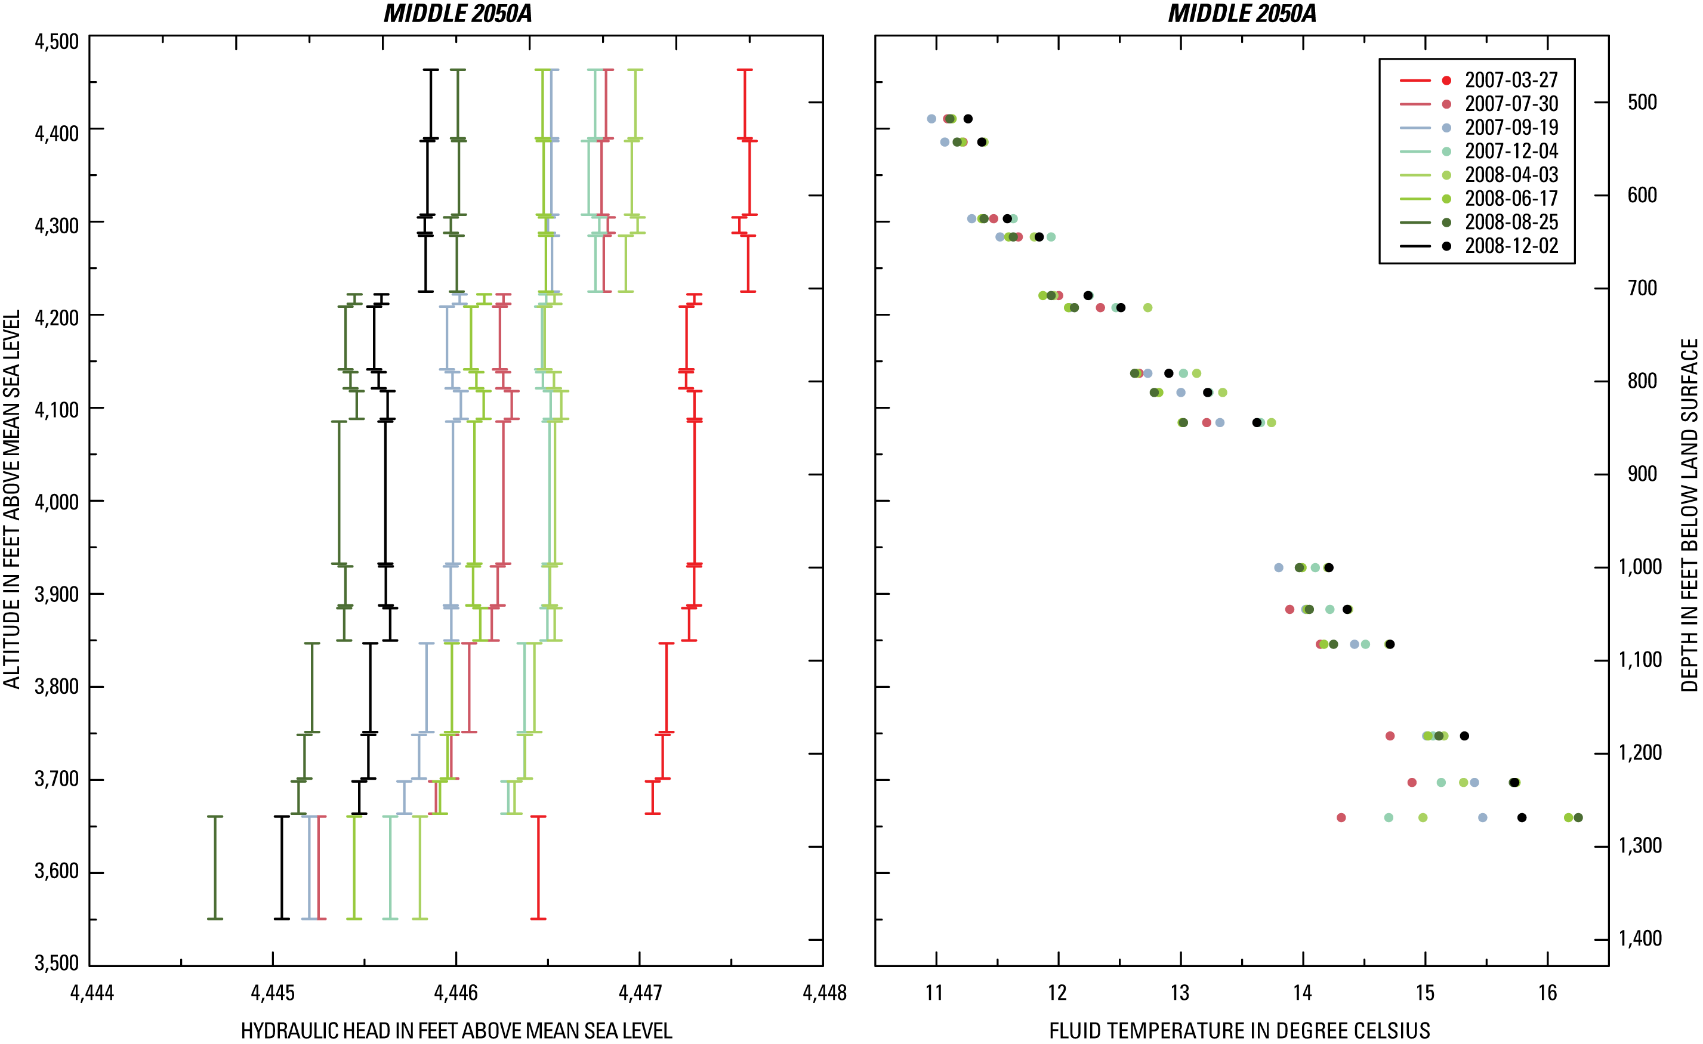
Notes:
During 2007 and 2008, quarterly visits to each of the six multilevel monitoring wells were made. Each site visit represents a single measurement event and results in a hydraulic head and temperature profile at each borehole. Shown here are the profiles of a single borehole MIDDLE 2050A. There are a total of eight hydraulic head profiles and eight temperature profiles for the period of record (colors are used to distinguish the different measurement events). A comparison among profiles shows that the general shape of the profile within a borehole was consistent among measurement events (this was the case for all boreholes). Assuming that within a borehole the profile shape does not change with time allows us to simplify our analysis of the data.

Slide 7
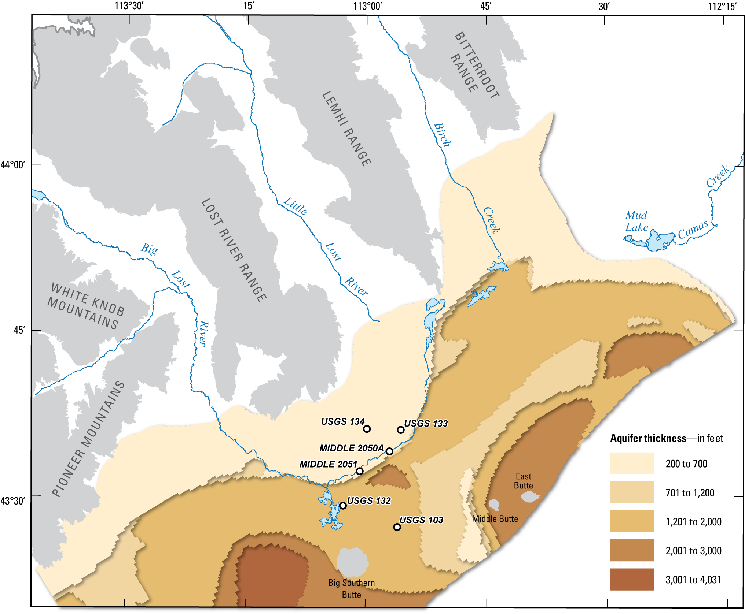
Notes:
Before going into the profile data, let’s briefly run through the major characteristics of the unconfined aquifer with respect to the multilevel monitoring systems. Shown here is the thickness of the aquifer estimated from land-surface electrical-resistivity surveys. The aquifer is at least 1,200 feet thick and may be 4,000 feet thick in the southern portion of the study area. The USGS 103 and 132 boreholes are located in a deeper portion of the aquifer in comparison to the other four multilevel systems. The MIDDLE 2051, MIDDLE 2050A, and USGS 133 boreholes are located along a transition zone; whereas, USGS 134 is clearly in a shallow portion of the aquifer and closest the mountain front.

Slide 8
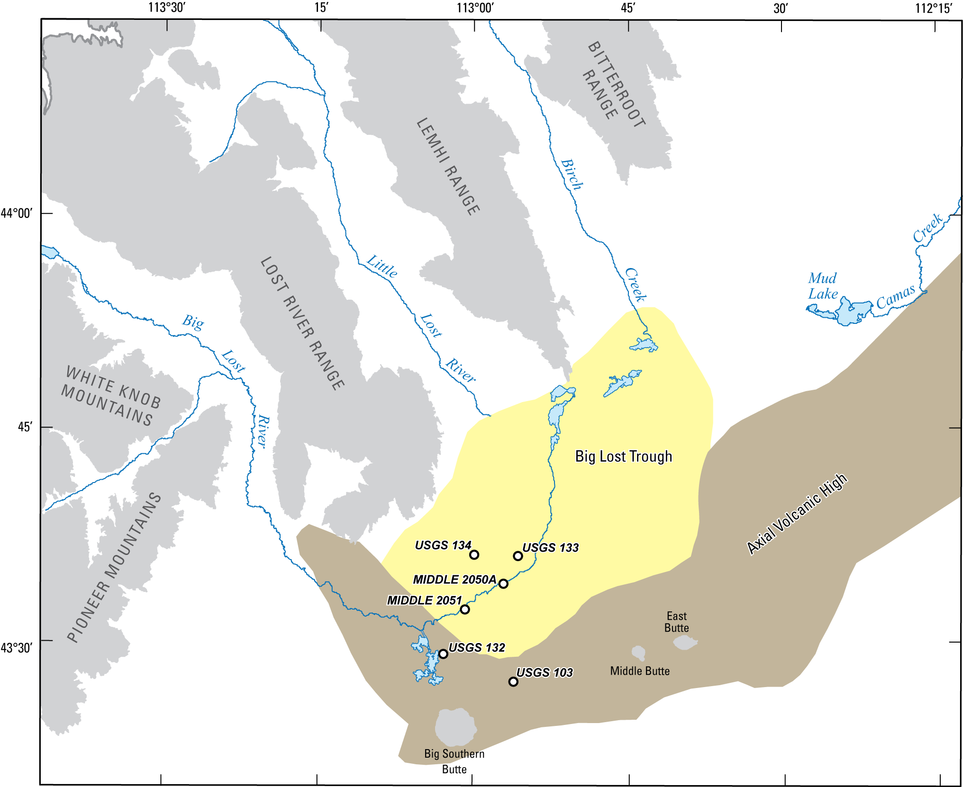
Notes:
Two of the major geologic features in the study area are the Axial Volcanic Highlands and the Big Lost Trough. The Axial Volcanic Highlands are areas of focused volcanisms resulting in high concentrations of volcanic vents and fissures; the major source of basaltic rocks on the plain. The Big Lost Trough is an area that contains significantly greater amounts of low-permeability sediment than other parts of the study area. The full extent and shape of these zones are not well understood but we will assume that the USGS 132 and 103 boreholes are located in the Axial Volcanic Highlands, with all other boreholes located in the highly heterogeneous area known as the Big Lost Trough.

Slide 9
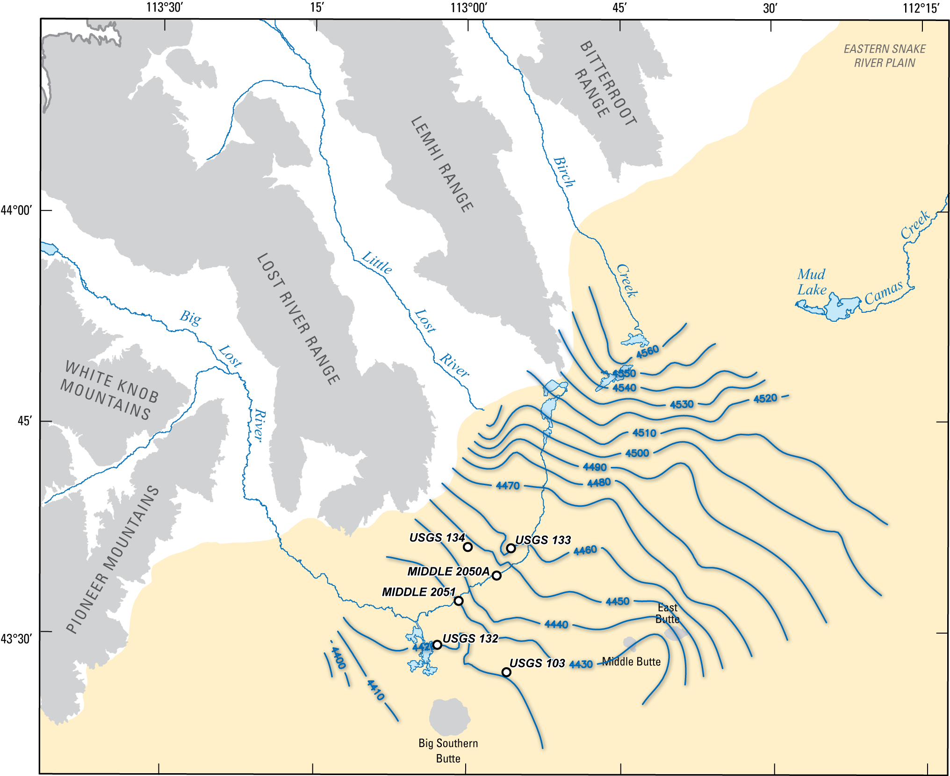
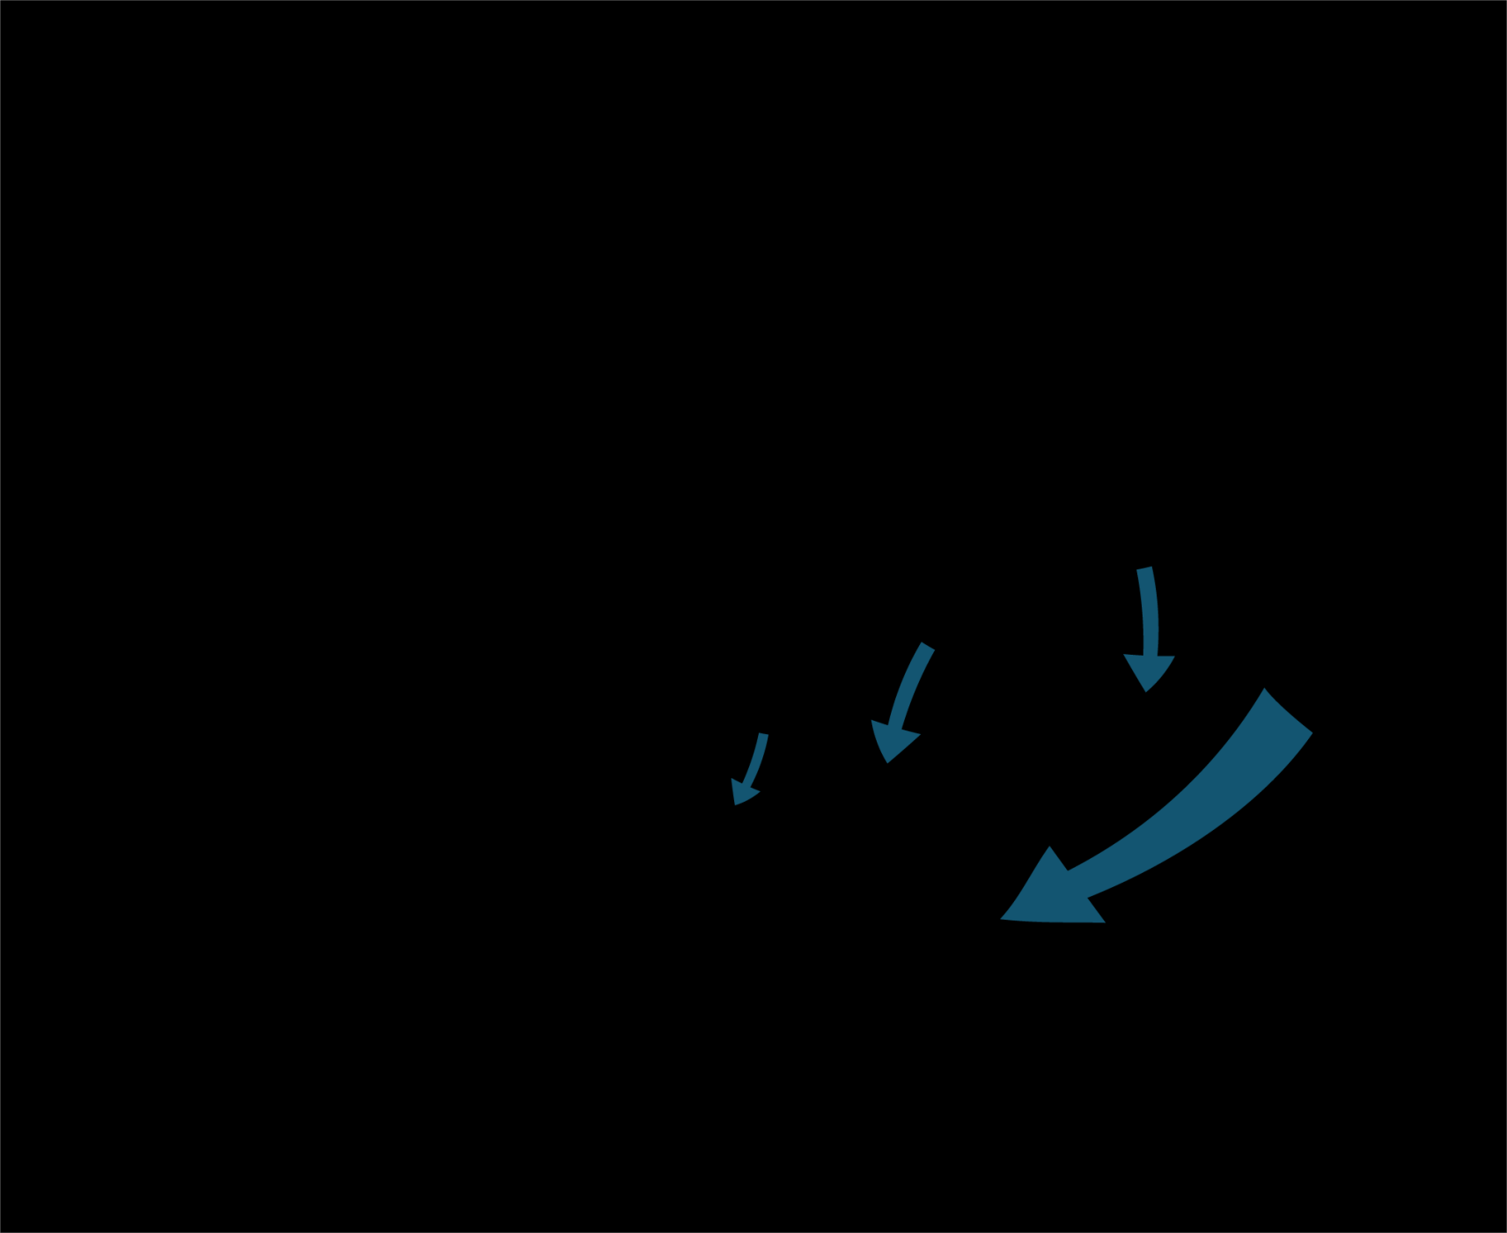
Notes:
The 2008 water-table, shown here as line contours of equal hydraulic head, along with independent groundwater velocity estimates, provide evidence of a refraction boundary separating the fast moving regional groundwater and the slower moving groundwater of the tributary valleys. Distinguishing the sources of water at each borehole is extremely difficult because of the close proximity of all boreholes to the mixing zone. One might speculate, however, that the water in the USGS 103 borehole is representative of the regional aquifer and groundwater within USGS 134 is representative of the tributary valley water.

Slide 10
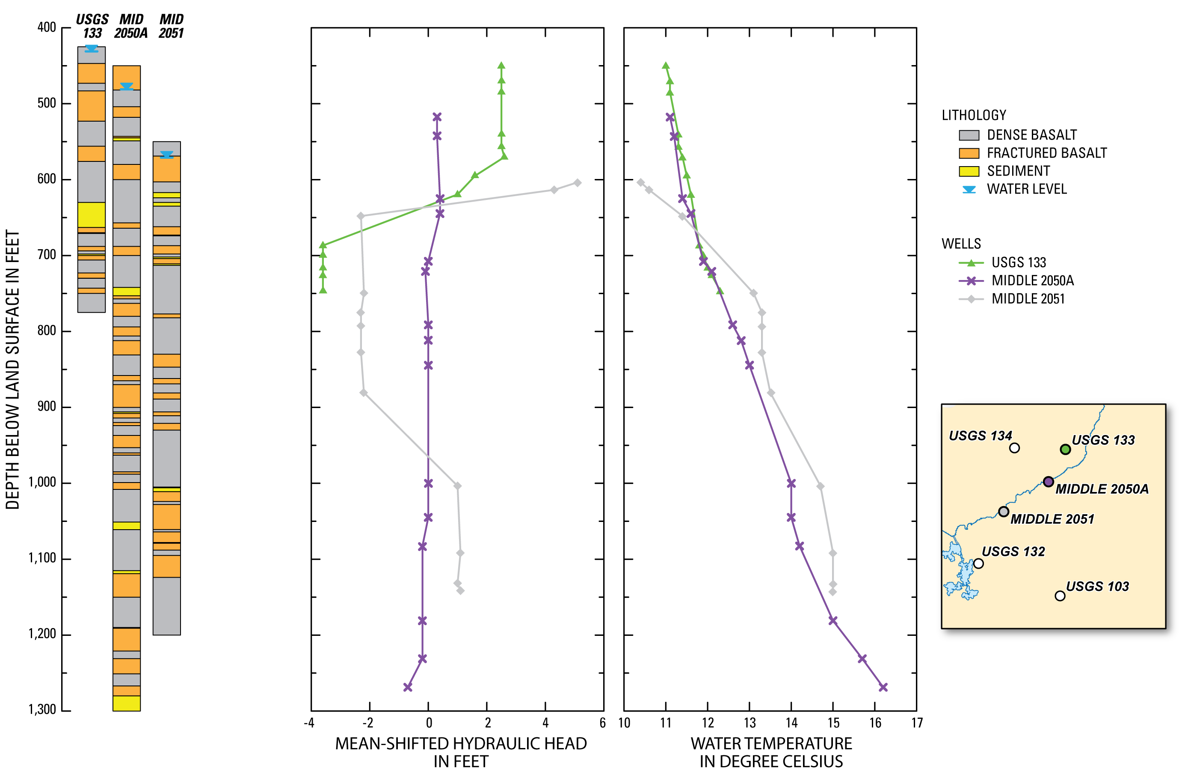
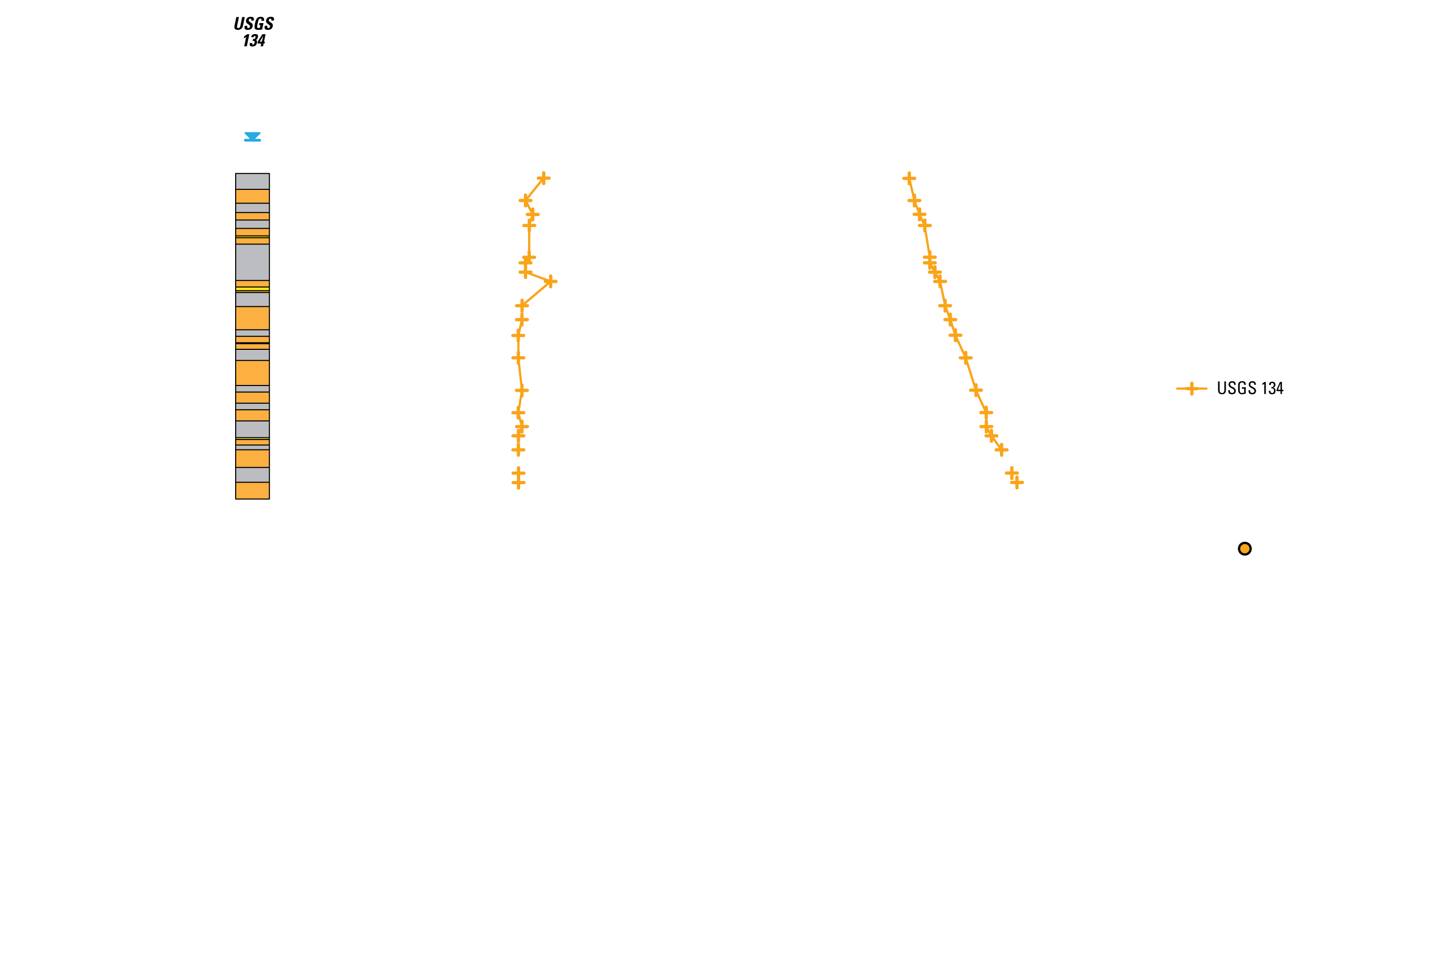
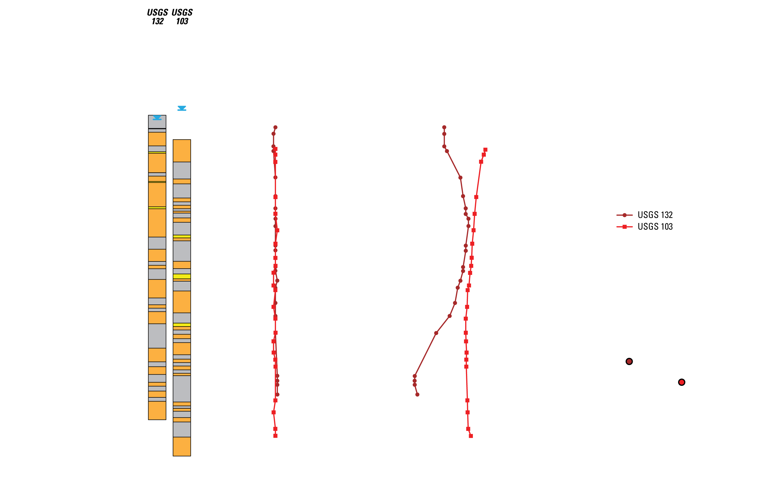
Notes:
Shown hear, is the lithologic-log, well completion, and June 2008 head and temperature profiles for all six boreholes. Note that the lithology logs for all boreholes were described using three lithologic units: fractured basalt, shown in orange, is a rock material of high to vary high hydraulic conductivity; dense basalt, shown in gray, is a rock material of low to vary low hydraulic conductivity; and sediment, shown in yellow, is a fined grained sand and silt mixture of very low hydraulic conductivity. The comparison of head profiles required that we converted head values to the mean-shifted hydraulic head (basically normalizing head values). Head and temperature profiles are represented as point-line plots for visual comparison purposes. If we look at head profiles in the USGS 133 and MIDDLE 2050A boreholes, and to some degree MIDDLE 2051, we see major head inflections coinciding with low permeability layers of sediment and dense basalt that restrict the vertical connectivity between fracture sets. However, sediment layers were not always sufficient for identifying major head inflections. For example, sediment layers in USGS 103 did not produce major head inflections. Where we saw low vertical head gradients (such as in boreholes USGS 103 and 132) the potential for vertical connectivity and flow was believed to be high. The general trend for most of the temperature profiles was an increasing temperature with depth. The exception to this trend are in boreholes USGS 103 and 132 where vertical connectivity between the fractures is believed to be high and convective heat transfer dominates. The reversal in direction within the USGS 132 temperature profile provides evidence of slower tributary valley waters mixing with the fast moving regional groundwater.

Slide 11
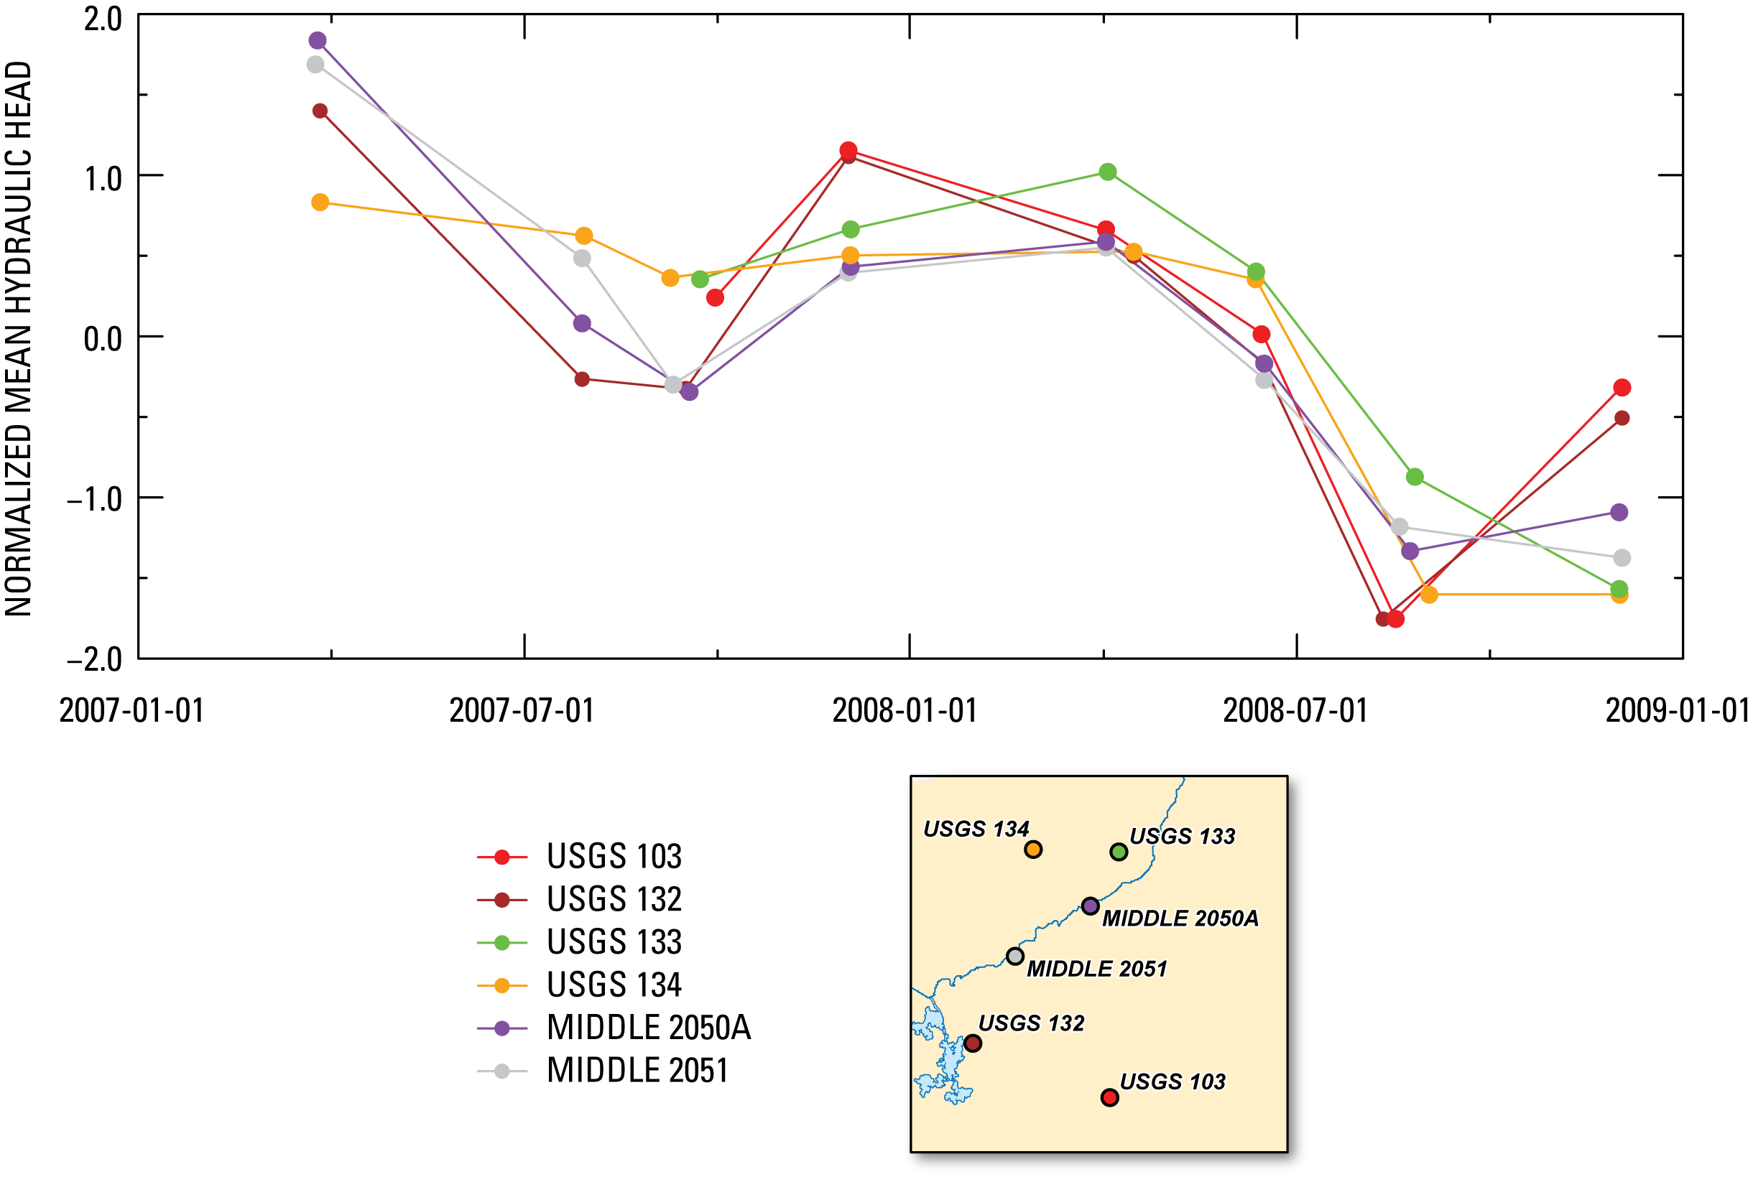
Notes:
The temporal correlation among multilevel monitoring systems was analyzed using the normalized mean hydraulic head. This plot shows that there is a moderate positive correlation among all boreholes, which reflects regional fluctuations in water levels in response to seasonal climatic changes. The temporal correlation is stronger when the location of boreholes within the aquifer is considered. For example, the USGS 103 and 132 boreholes are located in an area of highly permeable media with a relatively large saturated thickness, and relatively rapid groundwater flow. As expected, the correlation between these two wells is strongly positive with a temporal trend that differs slightly from the other boreholes.

Slide 12
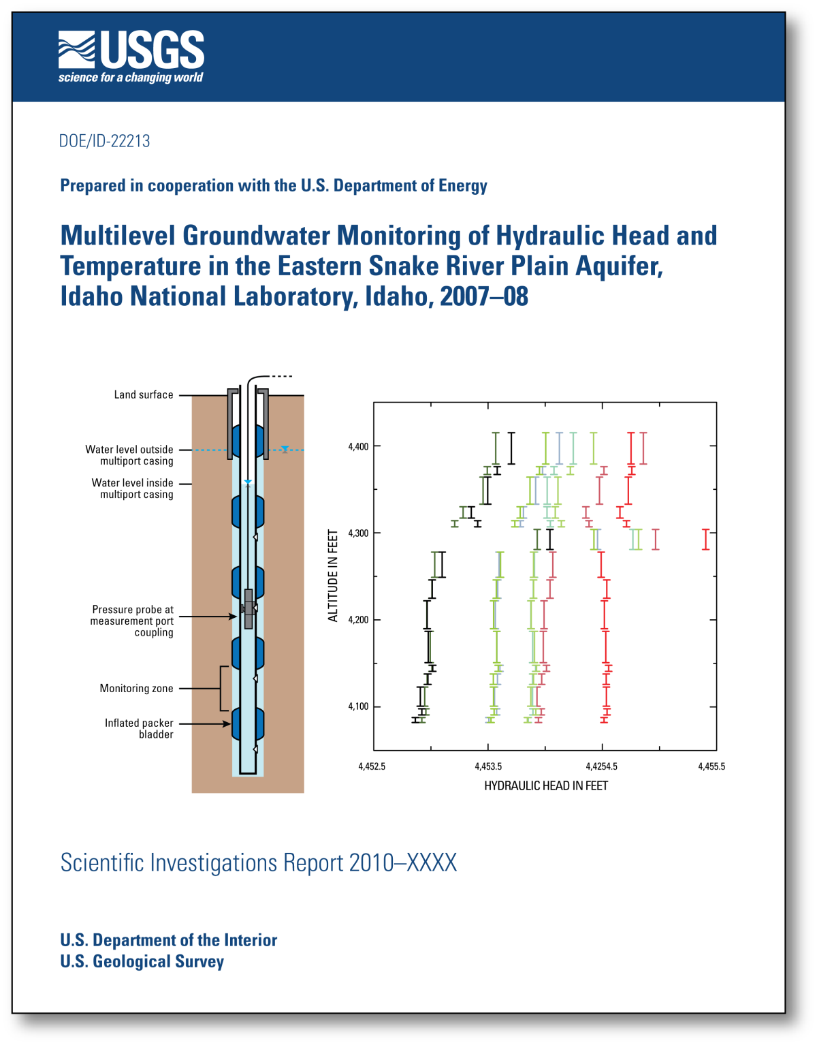

Questions
Jason C. Fisher
jfisher@usgs.gov
Notes:
Are there any questions?

